Slide 1
Gains Analysis
ABC School District
READ 180 and System 44
End-of-Year Summary Report
Results Based On Program Data
08/01/15 to 05/25/16
Academic Planning & Analysis

Slide 2
Executive Summary
In partnership with the district, Houghton Mifflin Harcourt has analyzed data from seven sites that implemented the READ 180 & System 44 reading intervention programs this school year.
Preliminary Analysis Observations
The analysis includes data from 95 READ 180 and 173 System 44 students.
At the time of the export, 86 READ 180 students and 159 System 44 students met Gains reporting criteria based on program use.
End-of-Year 2015-2016 data export indicates evidence of good growth with good software use in READ 180 and System 44.

Slide 3
Analysis Sample Selection Overview How Many Student Records Had Sufficient Data for Analysis?
Gains analysis inclusion criteria was set to include students in READ 180 and System 44 who had a minimum of 20 software sessions and a minimum of two test administrations at least eight weeks apart (Reading Inventory for READ 180 students and Phonics Inventory for System 44 students).

Slide 4
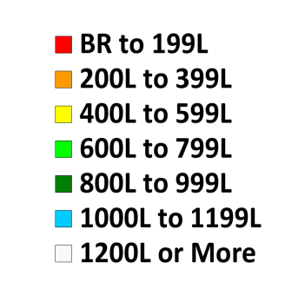
Placement Reading Inventory Overview Were Students Appropriately Placed in READ 180 & System 44?
KEY
Students with low Lexiles (BR to 400L in grades three to five & BR to 600L in grades six & up) should be screened with HMH Phonics Inventory. Pre-Decoder, Beginning or Developing Decoder status students should be placed in System 44 but Advancing Decoders belong in READ 180.
Students with limited phonemic awareness may not sustain higher Lexiles without Tier 3 intervention.

Slide 5
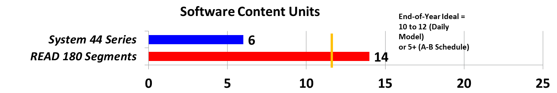
Summary Program Usage

Slide 6


Summary Reading Inventory Growth Metrics
Total Students in Reading Inventory Sample
86 Students
w/ 2+ Reading Inventory
160 Students
w/ 2+ Reading Inventory
These results are from students with 20+ software sessions and Reading Inventory tests that were at least eight weeks apart. Numbers for System 44 on subsequent slides may vary because they are based on Phonics Inventory rather than Reading Inventory results.

Slide 7
System 44 Student Phonics Inventory Results Total Students by Initial and Current Decoding Level
HMH recommends that System 44 students complete the Phonics Inventory three times a year for screening and monitoring progress. Students should be moving into higher levels of decoding as they progress through the program. Strongest results are typically achieved when students follow the System 44 Instructional Model daily and when care is taken to ensure a positive testing environment. Compare pre-test and post-test results to spotlight successes and identify areas that need additional focus. Review the Phonics Inventory Summary Progress Report for more information.
Analysis Note: Above data reflects ONLY those students with sufficient software usage and Phonics Inventory test administrations to meet the “Gains Analysis Sample” criteria.

Slide 8
Summary Recommendations
After the analysis of ABC School District’s 2015-2016 school year data the following recommendations are presented to maximize success in the future.
Recommendation 1
Recommendation 2
Recommendation 3
Note: This section is to be filled out by the Account Executive, Implementation Manager, or Project Manager before this analysis goes to print!

Slide 9
Implementation Reports

Slide 10
READ 180 Super Stars A Selection of Students with Notable Growth and Program Use
There were 41 READ 180 Super Stars, with evidence of both strong participation and Lexile gains. The students with the most growth relative to expectations are displayed above.
To reach “Reading Super Star” status, students must have:
At least 20 sessions (days) of software usage
At least one Segment completed in the READ 180 software
A growth rate between 1.0 and 4.0*
Pre-Test Reading Inventory Lexile score of over 100L.
*Students with greater than four times the normal growth rate may have had inappropriately low initial Lexile scores and are excluded from the Super Stars list.

Slide 11
Mean Lexile Gain and Goal by Site Mean Change in Lexile and Low End Growth Goal by School
This analysis is based on students who completed at least two Reading Inventory tests a minimum of eight weeks apart. Review the Reading Inventory Growth Summary Report for more information.
(Analysis Note: Sites with fewer than ten students or a negative change in average Lexile are not shown above)

Slide 12
READ 180 Usage and Reading Inventory Metrics
HMH recommends that READ 180 students complete the Reading Inventory three to five times a year for screening, monitoring progress, and making instructional decisions. Strongest results are typically achieved when students follow the READ 180 Instructional Model daily, and when care is taken to ensure a positive testing environment.

Slide 13
READ 180 Student Progress along Reading Inventory College & Career Ready Lexile Performance Levels
The above results show students’ Reading Inventory scores aligned to the Lexile Performance Levels set by MetaMetrics. As students move through the program, lower, non-proficient reader populations should decrease and higher, proficient reader populations should increase.
Lexile performance bands used in this analysis can be found in the Appendix.
Analysis Note: Charts above reflect Lexile data aligned to the Reading Inventory College & Career performance levels, regardless of whether students were administered Reading Inventory EE or Reading Inventory CC.

Slide 14
Students who Maintained Performance Level Lexile Results for Students Who Did Not Move Up/Down a Level
Students who maintained their performance levels demonstrated Lexile growth on average; these charts show the average advances they made towards growth goals. Below Basic students may need phonics instruction in order to demonstrate significant Lexile growth.

Slide 15
Below Basic READ 180 Student Results Summary Movement Between 200L Ranges of Below Basic Readers
Unlike other levels, the Below Basic College and Career Ready Range is 600L+ wide.
These reports show the progress of students who stayed in the Below Basic range by tracking their pre-test and post-test Reading Inventory results along 200-Lexile bands.

Slide 16
READ 180 Segments and Growth Reading Inventory Lexile Gains Relative to READ 180 Completion
Research indicates that students advance most quickly when they use READ 180 instructional software daily. In each software segment, students are expected to complete learning activities from five zones — Reading, Word, Spelling, Success, and Writing. Typically, it should take students five to 15 days (or sessions) to complete each segment. Review the results above to determine overall software use and completion, and compare those results against student Reading Inventory reading gains. Use SAM data from the READ 180 Results Summary Report to identify areas for continued focus.

Slide 17
Implementation Reports

Slide 18
System 44 Student Progress and Use Overview of Students’ Current Location in Program
The chart above shows how much content System 44 students have completed. Students should strive to complete at least 10 Series in a year, and to complete all 25 during their time in System 44.

Slide 19
System 44 Summary Implementation Metrics Student Content Completion as a Measure of Growth
On a standard daily implementation of System 44, schools can achieve 100 sessions of usage in a school year. In the standard implementation model, students should use the software for 15-20 minutes each day (or session). Regular use of software helps students complete the Topics more quickly; when all 160 Topics have been completed, the student is ready to exit System 44. Review the results here to identify successes as well as schools that may need additional support. Use the System 44 Response to Intervention Summary Report for more information.
Analysis Note: Because Phonics Inventory and Reading Inventory use varies greatly, this chart shows software use for ALL System 44-enrolled students to avoid skewing usage results based on test administration. If students were manually placed in a specific Series other than #1 or #4 then they are reported in the total and school-level results but cannot be reported by initial placement Series.

Slide 20
System 44 Student Phonics Inventory Results Total Students by Initial and Current Decoding Level
HMH recommends that System 44 students complete the Phonics Inventory three times a year for screening and monitoring progress. Students should be moving into higher levels of decoding as they progress through the program. Strongest results are typically achieved when students follow the System 44 Instructional Model daily and when care is taken to ensure a positive testing environment. Compare pre-test and post-test results to spotlight successes and identify areas that need additional focus. Review the Phonics Inventory Summary Progress Report for more information.
Analysis Note: Above data reflects ONLY those students with sufficient software usage and Phonics Inventory test administrations to meet the “Gains Analysis Sample” criteria.

Slide 21
Summary Phonics Inventory Results Accuracy and Fluency Metrics by School
Results for System 44 students with two or more Phonics Inventory administrations & 20+ software sessions are displayed above with the initial and most recent tests providing metrics. Students with limited Series completion tend not to demonstrate changes in Accuracy and Fluency.
Accuracy growth indicates students have improved their ability to recognize and decode words—a prerequisite skill for fluent reading
Fluency growth indicates students have improved their ability to recognize and decode words with automaticity—a prerequisite skill for reading comprehension. Fluency growth of 4 points is 1 year of growth
Students with Advancing Phonics Inventory decoding levels tend to demonstrate the greatest Lexile growth by end of year Reading Inventory administration

Slide 22
Phonics and Reading Inventory Results Overview of Test Results for System 44 Students
159 students
w/ 2+ Phonics Inventory
160 students
w/ 2+ Reading Inventory
This chart shows that foundational reading skills are improving; reading comprehension results often depend upon foundational reading skills.
Meeting annual goals for Lexile growth goal is more likely when students reach Series 20 to 25 or when students demonstrate Advancing Decoder status on Phonics Inventory.
Analysis Note: Above data reflects ONLY those students with sufficient software usage to meet the “Gains Analysis Sample” criteria and Phonics Inventory/Reading Inventory tests at least eight weeks apart.

Slide 23
Appendix

Slide 24
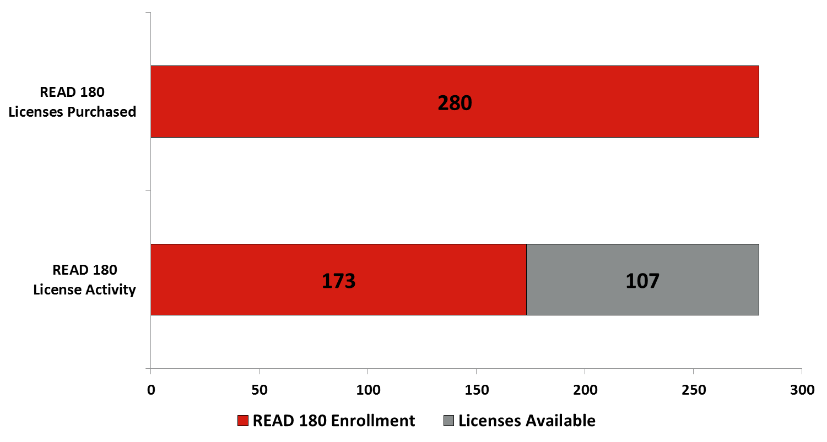
READ 180 License Utilization
Enrolled student counts come directly from the export and are the most accurate reflection of current license utilization. Available license counts reflect total purchased licenses. For more detailed license availability counts, including number of activated licenses, please work with your Account Executive and Customer Service reps.

Slide 25
READ 180 Data Inclusion Process by School
Yellow highlights show where students were lost from a site sample.
To be in the Gains Analysis, students need to have at least two Reading Inventory tests a minimum of eight weeks apart and must have at least ten software sessions per semester (20 per year). This table shows how many students from each site met each criteria for analysis. As you go from left to right, the number shows how many students met that criteria and all others to the left.

Slide 26
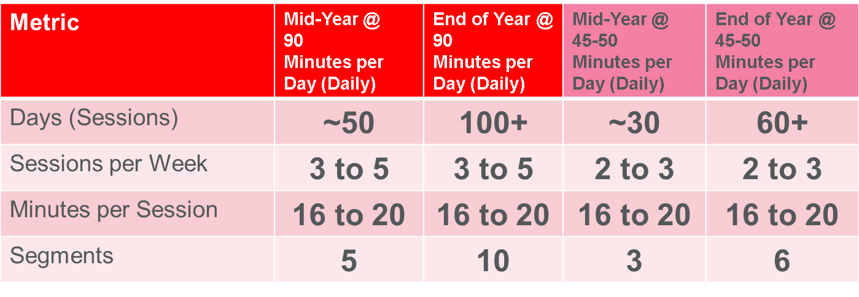
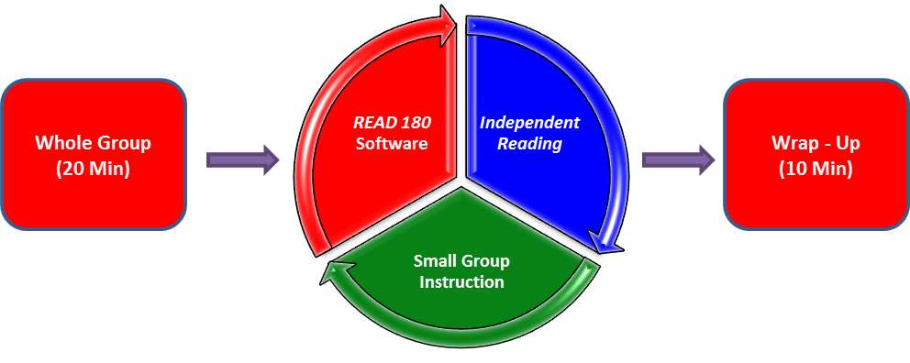
Implementation Model Affects READ 180 Usage Metrics

Slide 27

READ 180, rSkills and Reading Counts Users Compare Total Students Using Programs Associated with Each Rotation
READ 180 software usage indicates that part of the READ 180 Intervention Solution is happening…
- rSkills tests indicate Small Group Instruction occurs
- Reading Counts tests passed indicate students read books during Independent Reading.
3 slices of the pie are equal when ALL rotations occur.
Only 84 students in READ 180 have completed work in all 3 rotations.

Slide 28
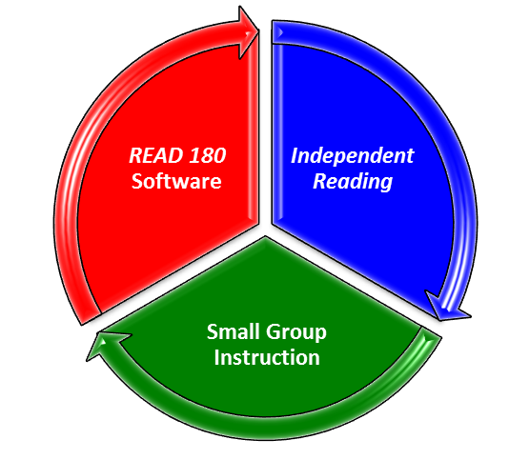
READ 180, rSkills and Reading Counts Total Participants by School

Slide 29
READ 180 Classroom Summary Export Data Aligned Software and Test Results₁
1 The READ 180 class alignment for each student is drawn from the SAM export; if classes are not properly aligned to the program, then unexpected values will appear in the export and results above.

Slide 30
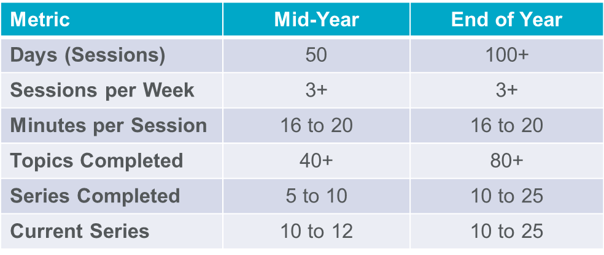
System 44 Usage Metrics Expectations: Blended or Stand-Alone Model Implementations
Stand-Alone Model
System 44 Software
Small Group Instruction
Introduction
(5 Min)

Slide 31
System 44 Data Inclusion Process by School
Yellow highlights show where students were lost from a site sample.
To be in the Gains Analysis, students need to have at least two Phonics Inventory tests a minimum of eight weeks apart and must have at least 10 software sessions per semester (20 per year). This table shows how many students from each site met each criteria for analysis. As you go from left to right, the number shows how many students met that criteria and all others to the left.
Also, 160 students in System 44 had necessary software sessions and eight or more weeks between Reading Inventory test administrations.

Slide 32
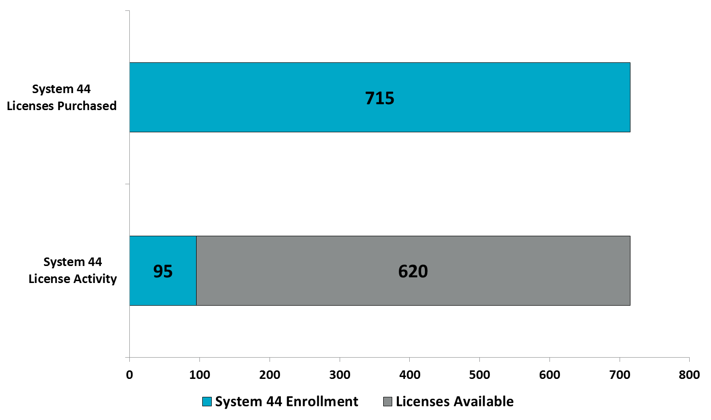
System 44 License Utilization
Enrolled student counts come directly from the export and are the most accurate reflection of current license utilization. Available license counts reflect total purchased licenses. For more detailed license availability counts, including number of activated licenses, please work with your Account Executive and Customer Service reps.

Slide 33
Low and High End Lexile Growth Goals Using Student’s Fall Lexile & Grade Level to Set Goals for Students
HMH Reading Inventory can be used to set reading goals and to compare students’ response to instruction to growth expectations from fall to spring.
Monitoring growth helps educators to determine if students are on track to meet achievement standards.
Expected growth is determined by fall Reading Inventory Lexile and grade level. For more on using fall Lexiles to set growth goals consult the professional paper Growth Expectations – Setting Achievable Goals
Tier III reading intervention students are unlikely to reach personal growth goals without a firm grasp of phonemic principles.
HMH recommends that System 44 students receive three Phonics Inventory Tests to monitor emerging skills.
Without knowledge of a student beyond data in the export, Gains Analysts assign student records with personal Lexile growth goals derived from tables similar to the one at the right.

Slide 34
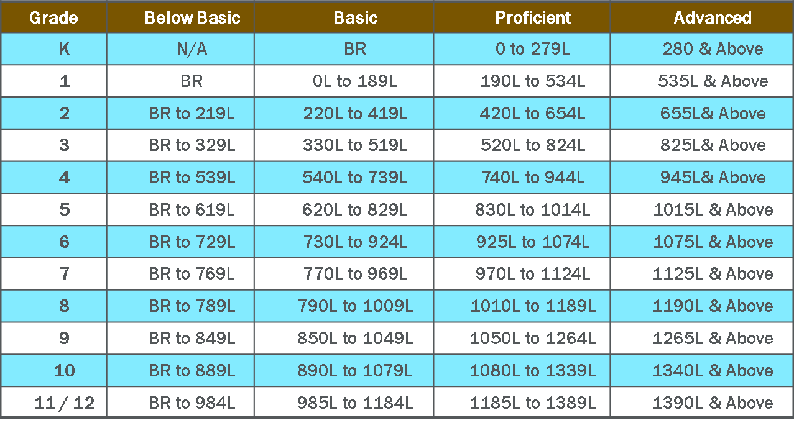
College and Career Ready Proficiency Levels Spring Proficiency Targets for Students to Meet Rigorous Demands
With the release of Reading Inventory College & Career, HMH and MetaMetrics (creator of the Lexile Framework) updated the Lexile ranges that comprise Below Basic, Basic, Proficient, and Advanced performance levels for each grade. To establish the new performance levels, MetaMetrics conducted an extensive study of college and career texts. The new score ranges more accurately reflect the increased expectations for college and career readiness and indicate whether students are on track to comprehend college and career level texts by the end of high school.

